Slide 1
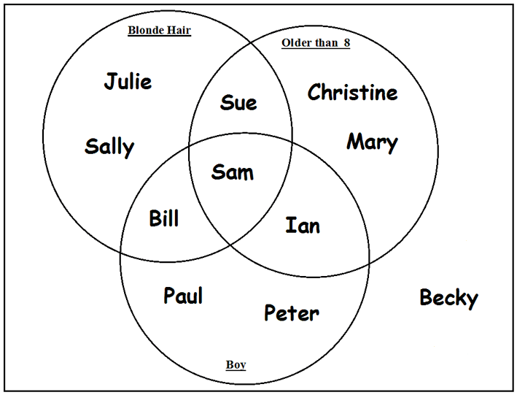
Sets and Set Operations
Dr. Abolfazl Saghafi
Assistant Professor of Statistics & Data Science
Data Science Program Director
Chapter 3 Part 2
http://factsabouthull.blogspot.com/2014/11/fact-36-venn-diagrams-were-conceived-by.html
Notes:
The second tool we need to define probability is set theory which we discuss in this section.
Probability is a set function, it operates on sets, here we go through definition of sets and different operations defined on sets.

Slide 2
Set
• You cannot have repeated elements in a set
• Members of sets should be well-defined
• Order of members in a set is not important, but we usually write members in order to make it easy to distinguish elements
A set is any well-defined collection of distinct objects.
The objects that compose the set are the members or elements of the set.
We denote sets symbolically by capital letters, A, B C, … and list their members in curly braces {…}. For example
A={1, 2, 3}
= {3, 1, 2} order doesn’t matter

Slide 3
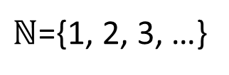
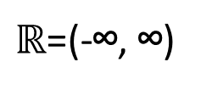
Examples
Set of number of spots on a regular die:
B={1, 2, 3, 4, 5, 6}
Set of Natural numbers:
$ℕ$={1, 2, 3, …}
Set of Real numbers:
$ℝ$=(-∞, ∞)
Set of days in a week:
C={Mon, Tue, Wed, Thu, Fri, Sat, Sun}
Set of all tall men
It is not a set since its elements
are not exactly specified
• Sets could have any members beside numbers, for example shapes, names, etc.

Slide 4
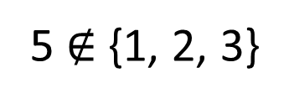
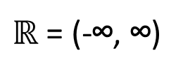
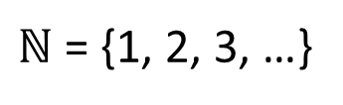
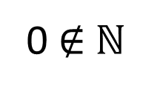
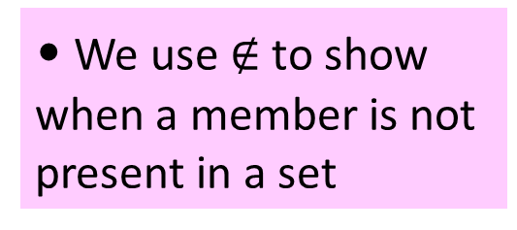
Membership
A = {1, 2, 3}
B = {1, 2, 3, 4, 5, 6}
If x is a member/element of set A, we write:
$ℕ$ = {1, 2, 3, …}
Read as: x is an element of A
Or set A includes x
C = {Mon, Tue, Wed, Thu, Fri, Sat, Sun}
Thus, given our defined sets, we have
$ℝ$ = (-∞, ∞)
1 ∈ {1, 2, 3}
Or 1 ∈ A
• We use $∉$ to show when a member is not present in a set
Mon ∈ {Mon, Tue, Wed, Thu, Fri, Sat, Sun}
5 $∉$ {1, 2, 3}
{5} ? {1, 2, 3}
0 $∉$ $ℕ$
Notes:
In the last example, what is the relation between {5} and {1, 2, 3}?
Pay attention that both of {5} and {1,2,3} are sets

Slide 5
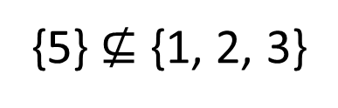



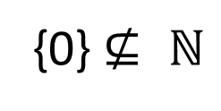
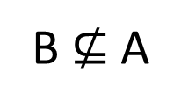
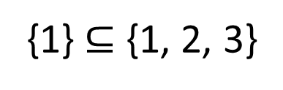
Subset
A = {1, 2, 3}
B = {1, 2, 3, 4, 5, 6}
If all the members of set A are also members of set B, then A is a subset of B, denoted A ⊆ B
$ℕ$ = {1, 2, 3, …}
Otherwise, we write A $⊈$ B
“A is a subset of B”
C = {Mon, Tue, Wed, Thu, Fri, Sat, Sun}
“A is NOT a subset of B”
$ℝ$ = (-∞, ∞)
Thus, given our defined sets, we have
A $⊆$ $ℕ$
B $⊆$ $ℕ$
• A = B
if and only if
A ⊆ B AND B ⊆ A
B $⊈$ A
{5} $⊈$ {1, 2, 3}
{1} $⊆$ {1, 2, 3}
{0} $⊈ ℕ$

Slide 6
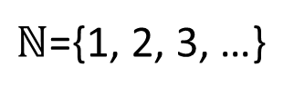
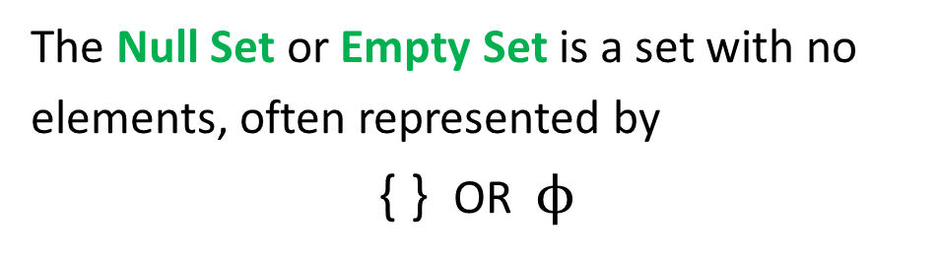
Venn Diagram
Empty Set / Universal Set
The Null Set or Empty Set is a set with no elements, often represented by
{ } OR $ϕ$
Venn diagram is used to show set operations, we use circles to show sets, use rectangles to show the universal set. For example,
“Greek letter phi”
A={1, 2, 3}
B={1, 2, 3, 4, 5, 6}
The Universal Set is the set of all elements currently under consideration, and is often represented by
U
$ℕ$={1, 2, 3, …}
N
B
A
• Empty set is a subset of any set.
Notes:
There are some important sets that we use A LOT

Slide 7
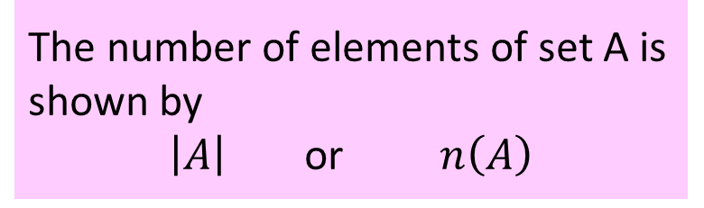
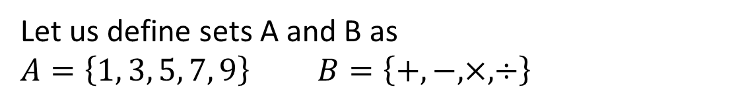
Example
The number of elements of set A is shown by
$\left|A\right|$ or $n\left(A\right)$
Let us define sets A and B as
$A=\left\{1, 3, 5, 7, 9\right\}$ $B=\left\{+, −, ×, ÷\right\}$
Use the correct set symbol so that the following statements make sense.
U
B
1 A 5 A {5} A {} A
{1, 5} A {1, 3, 5, 7, 9} A A B
+ B ^ B φ B B {φ}
A
B {+, -} B A B φ
|B|= n(A)= n(U)=
Notes:
1$∈$A 5$∈$A {5}$⊆$A {}$⊆$A
{1,5}$⊆$A {1,3,5,7,9}$=$A A$⊈$B
+$∈$B ^$∉$B $ϕ⊆$B B$⊈ϕ$
B$⊈${+,-} B$⊈$A ?
|B|=4 n(A)=5 U={1,3,5,7,9,+,-,*,/}, n(U)=9

Slide 8

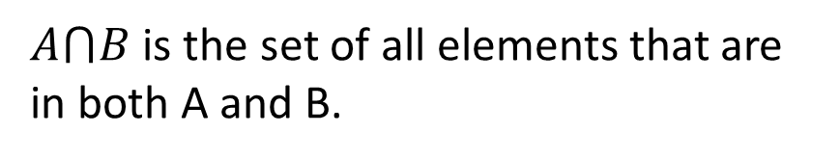

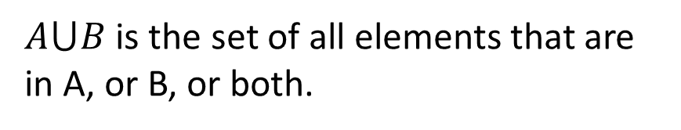
Union Set ($∪$)
Intersection Set ($∩$)
$A⋃B$ is the set of all elements that are in A, or B, or both.
$A⋂B$ is the set of all elements that are in both A and B.
Read as “A OR B”
“A Union B”
Read as “A AND B”
“A Intersect B”
A
B
A
B
Commutative:
Associative:
Notes:
Union is the action of joining, it creates bigger sets. Intersection is the act of finding common elements, it creates smaller sets.

Slide 9
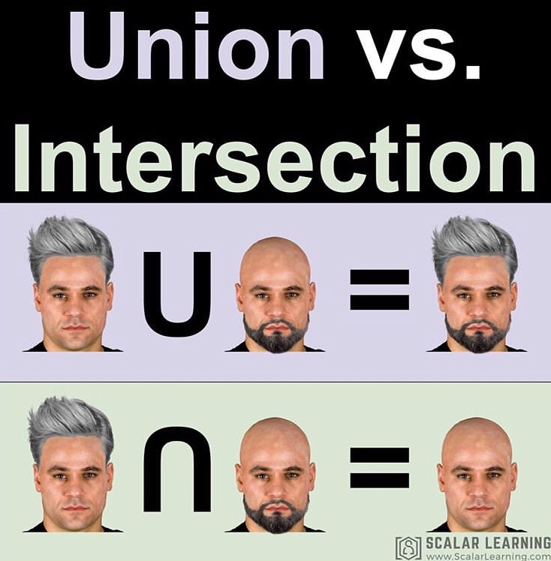
Example
Consider the set of positive integers A={1,3,4,6,8} and B={1,2,3,4,5,6}. Construct the union set and intersection set for A and B.
U
U
A
B
A
B
1
1
2
2
3
4
3
4
8
8
6
5
6
5
Notes:
$A∪B$={1,2,3,4,5,6,8}
$A∩B$={1,3,4,6}

Slide 10
Example
U
Suppose A={1,3,5,7,9}, B={1,5}, C={2, 5,9}. Determine the members of each set operation
A
3
B
7
C
1
5
9
2
Notes:
$A∩B$={1,5}
$A∩C$={5,9}
$B∩C$={5}
$A∩B∩C$={5}
$C∪B$={1,2,5,9}

Slide 11
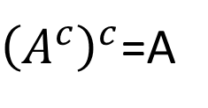
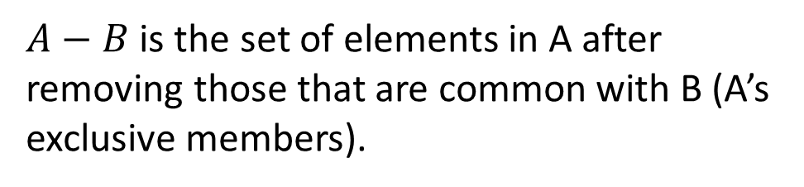
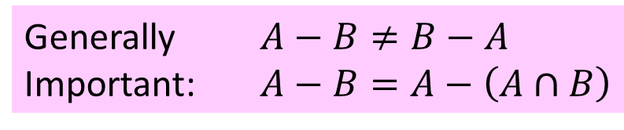
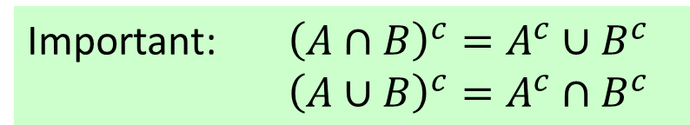
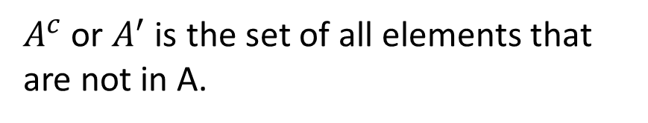
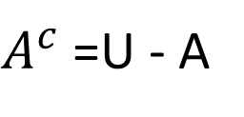
Difference Set
Complement Set
$A−B$ is the set of elements in A after removing those that are common with B (A’s exclusive members).
$A^{c}$ or $A^{′}$ is the set of all elements that are not in A.
U
$A^{c}$=U - A
A
${\left(A^{c}\right)}^{c}$=A
A
B
A
B
Generally $A−B≠B−A$
Important: $A−B=A−\left(A∩B\right)$
Important: ${\left(A∩B\right)}^{c}=A^{c}∪B^{c}$
${\left(A∪B\right)}^{c}=A^{c}∩B^{c}$

Slide 12
Example
Suppose A={1,2,3}, B={3,4,5,6}. Show
Notes:
A – B = {1,2,3} - {3,4,5,6} = {1,2}
B’ = U – B = {1,2,3,4,5,6} – {3,4,5,6} = {1,2}

Slide 13
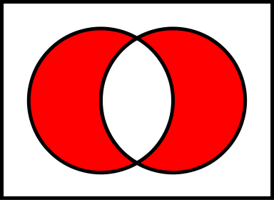
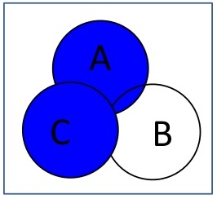
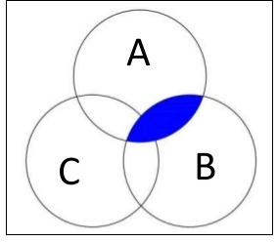



Example
Show the set representation of following Venn diagrams.
A
B
A
B

Slide 14
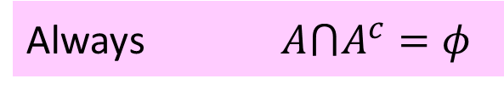
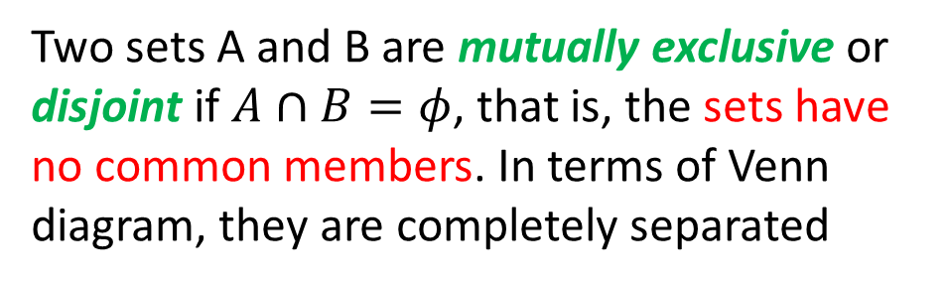
Mutually Exclusive
Symmetric difference
Two sets A and B are mutually exclusive or disjoint if $A∩B=φ$, that is, the sets have no common members. In terms of Venn diagram, they are completely separated
The following operation is known as symmetric difference
A
B
A
B
Always $A⋂A^{c}=φ$

Slide 15
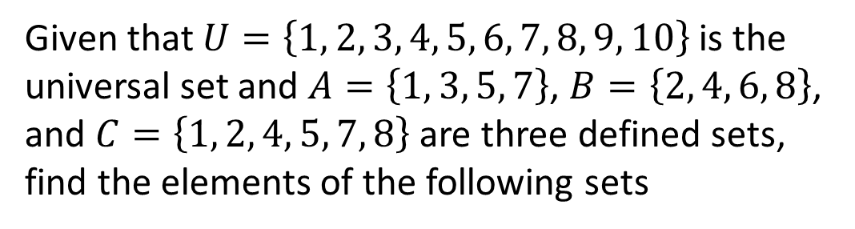
Example
Given that $U=\left\{1, 2, 3, 4, 5, 6, 7, 8, 9, 10\right\}$ is the universal set and $A=\left\{1, 3, 5, 7\right\}$, $B=\left\{2, 4, 6, 8\right\}$, and $C=\left\{1, 2, 4, 5, 7, 8\right\}$ are three defined sets, find the elements of the following sets
Notes:
{1, 3, 5, 7, 9, 10}
{1, 2, 3, 4, 5, 6, 7, 8}
{1, 3, 5, 7}∩{1, 3, 5, 7, 9, 10} = {1, 3, 5, 7}
({1, 3, 5, 7}U{1, 2, 4, 5, 7, 8})^{c} = {6, 9, 10}

Slide 16
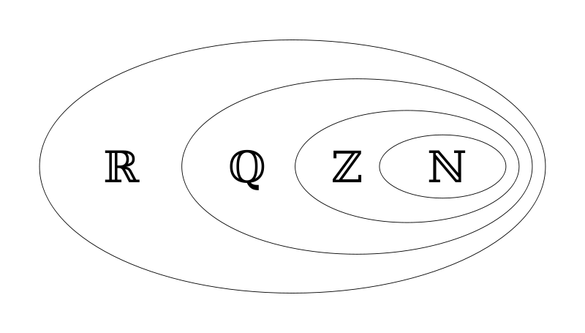

Important Sets
Some of the important sets of numbers in
mathematics are
Natural numbers:
Integers:
stands for the German word Zahlen
Rational numbers:
Real numbers:
Irrational numbers
Notes:
A rational number is any number that can be expressed as the fraction of two integers.
Can you mention some irrational numbers, ℮ and π are irrational numbers
Do you know of a set bigger than R?

Slide 17
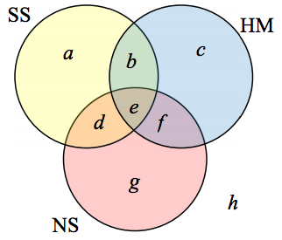
Practice Problems Part 2
1. Suppose the given Venn diagram shows students who took Social Sciences (SS), Humanities (HM), and Natural Sciences (NS). Show the proper set operations in the following questions.
a) What is the Universal set here?
b) Which students took both SS and HM?
c) Which students took SS or NS?
d) Which students took all the three courses?
e) Did any of the students take none of the SS, HM, NS?
f) Which students took only SS?
g) Which students took SS but not HM?
Notes:
Answers are provided in Ch3 Practice Problem Solutions

Slide 18
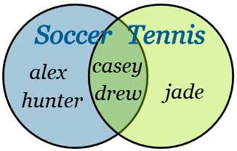
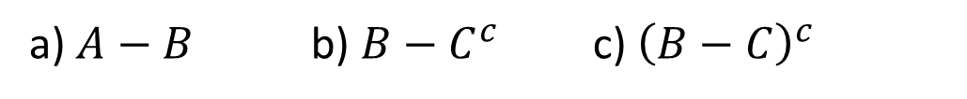
Practice Problems Part 2
2. The following is the list of your 10 good friends:
{alex, blair, casey, drew, erin, francis, glen, hunter, ira, jade}
Given the Venn diagram, answer the following questions by showing the proper set operation. Which of the friends
a) play tennis only? b) play both tennis and soccer?
c) play neither tennis nor soccer?
3. Given that U={1,2,3,4,5,6,7,8,9,10} is the universal set and A={1,3,5,7}, B={2,4,5,8}, and C={1,2,4,5,7,9} are three defined sets, find the elements of the following sets
a) $A−B$ b) $B−C^{c}$ c) ${\left(B−C\right)}^{c}$
4. Suppose there are 100 third-year students. 40 of them take the module “Sequential Algorithms” and 80 of them take the module “Multi-Agent Systems”. 25 of them took both modules. How many students took neither?
Notes:
Answers are provided in Ch3 Practice Problem Solutions
More examples on set theory can be find here:
http://www.mathsisfun.com/sets/sets-introduction.html
https://www.mathsisfun.com/sets/venn-diagrams.html

